Slide 1



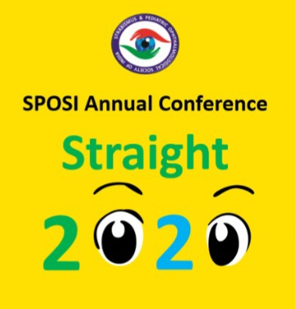
Improvement of stereo acuity following squint correction in children of different variety of squint
There is no financial interest of any of the authors behind conducting this study and no financial assistance was provided by any institution or organization and there are no competing interests, conducted after approval of ethical committee
PRESENTING AUTHOR-
Dr Rupali Barnwal
CO AUTHORS-
Dr Shreya Shah
Dr Mehul Shah
Dr Ruhi Gunay

Slide 2

Aim:
To evaluate whether stereo acuity improved following strabismus correction and what is impact of correction in variety of strabismus in pediatric patients

Slide 3

Method
Study was conducted after obtaining ethical committee clearance.
No financial interest is involved
We enrolled children having strabismus. Anterior and posterior segment examinations were done with stereo acuity evaluated.
After appropriate treatment, stereo acuity were evaluated again after three months.
P value (<0.05) considered significant

Slide 4

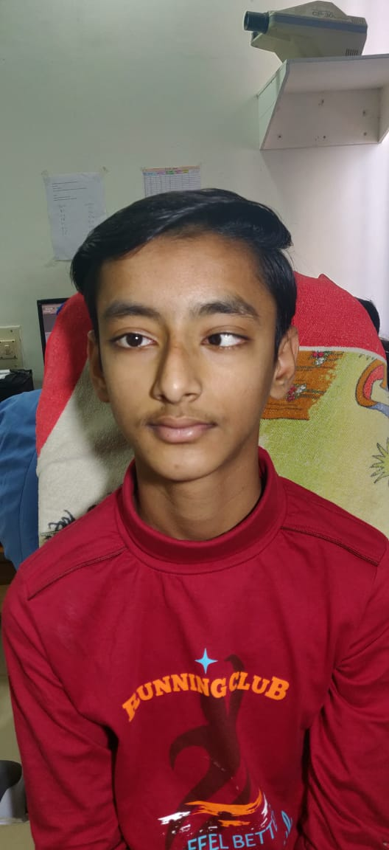

Slide 5

OBSERVATION TABLE
SAMPLE SIZE | 69 CHILDREN
MALES | 28 (26%)
FEMALES | 50 (64%)
MEAN AGE | 10 +/- 4.7 YEARS
ESOTROPIA | 40 PATIENTS

Slide 6
OBSERVATION TABLE
EXOTROPIA | 27 PATIENTS
PARALYTIC SQUINT | 2 PATIENTS
p VALUE | 0.00
MEAN PRE OPERATIVE STEREOPSIS | 800 SECONDS OF ARC
MEAN POST OPERATIVE STEREOPSIS | 400 SECONDS OF ARC
FOLLOW UP DURATION | 3 MONTHS

Slide 7

Result
Here we enrolled 69 children with mean age 10.1 ± 4.5 and found significant improvement in vision and stereo acuity after treatment (p=0.00) in children with squint. Mean stereopsis pre and post correction was 800 and 400.

Slide 8
Conclusion
Appropriate treatment makes functional changes in terms of stereo acuity
Significant difference found when compared with pre operative finding children following squint correction.
Significant difference documented in constant variety not in alternate type.

Slide 9

THANK YOU

